Slide 1
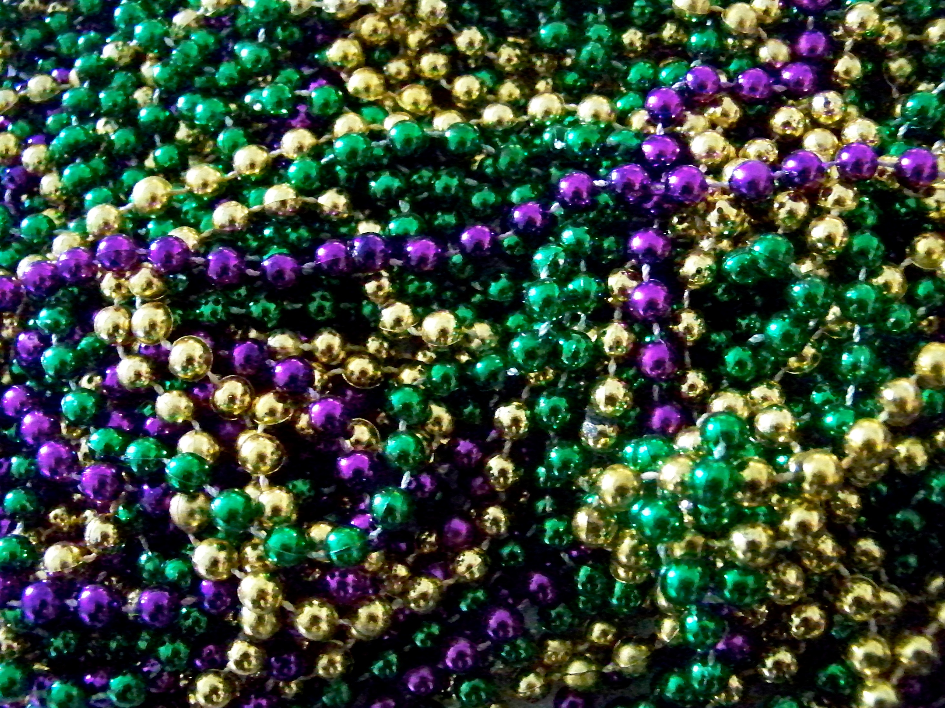
Mardi Gras in New Orleans

Slide 2
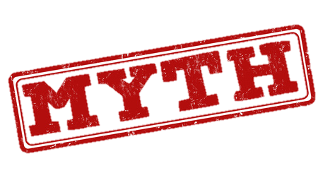
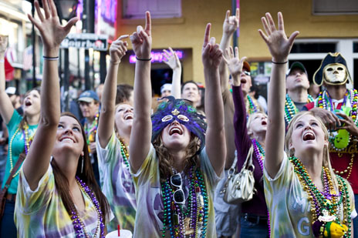
Media Portrayal of Mardi Gras
Mardi Gras is one big parade put on by the city in the French Quarter of New Orleans on Fat Tuesday where people drink a lot and woman lift their tops to earn beads.

Slide 3
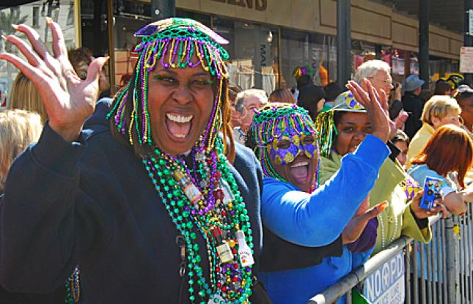
Objective
At the end of class, you will rewrite the previous statement, correcting the six falsehoods, with a partner.

Slide 4
The History & Traditions of Mardi Gras

Slide 5
Blaine Kern’s Mardi Gras World

Slide 6
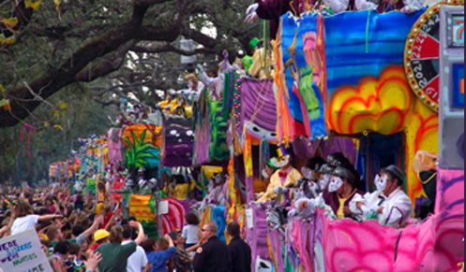
Mardi Gras Parades
Since the 1920s, most of the Krewes (parade-organizing groups) hold their parades west of Canal Street due to their large floats and the narrow streets in the French Quarter (east of Canal Street).

Slide 7
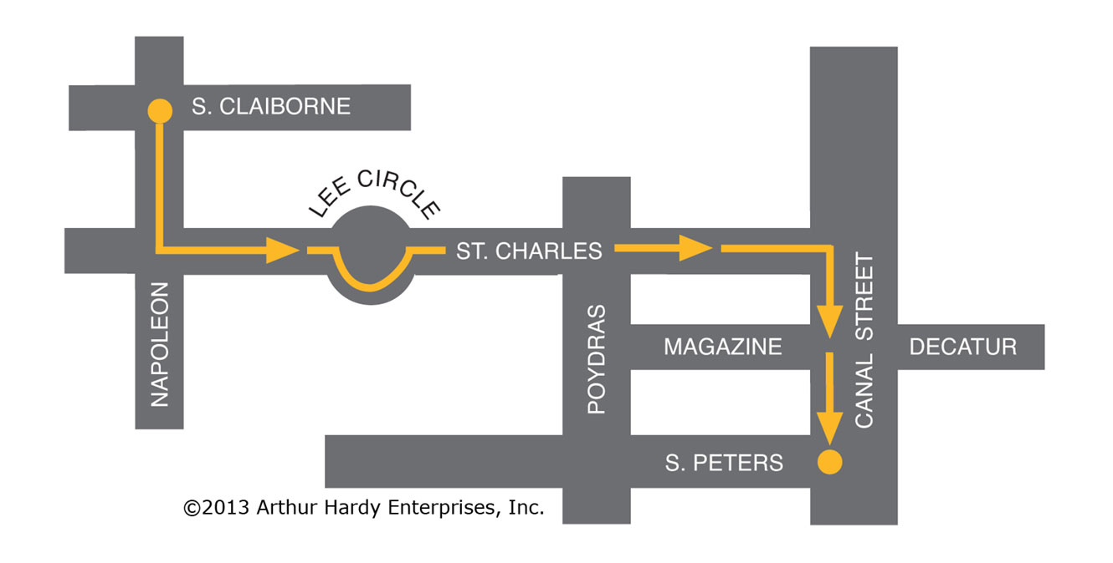
Mardi Gras Parades

Slide 8
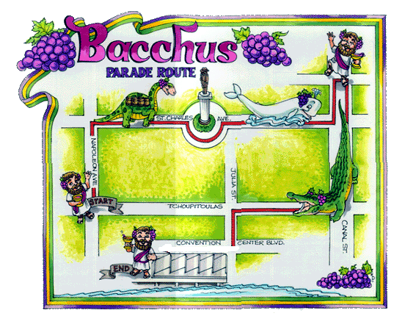
Mardi Gras Parades

Slide 9
Mardi Gras Parades

Slide 10
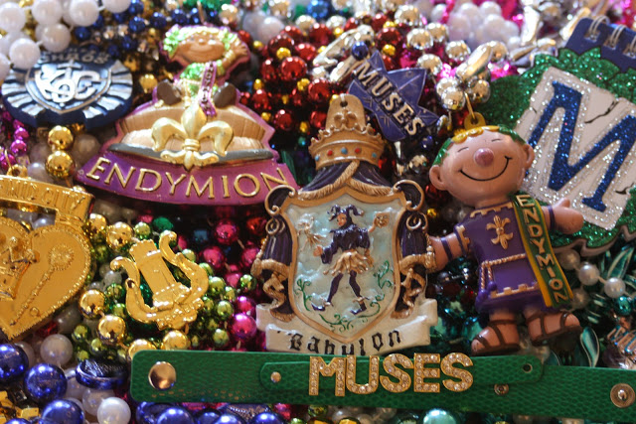
Mardi Gras Throws
Throws are necklaces of plastic beads, doubloons, which are stamped with the krewes’ logo, parades themes and the year, cups, which are referred to as New Orleans dinnerware, plus an array of toys.

Slide 11
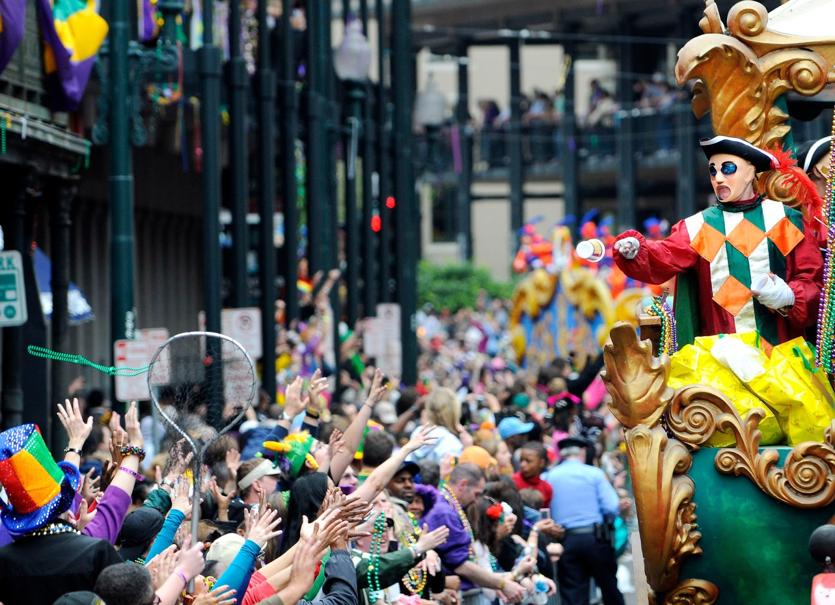
Mardi Gras Throws
Spectators shout “Throw me something, mister!” to krewe members. Unless it is an all-woman krewe, when one shouts “Throw me some love, dawlin’!”
If a throw lands on the ground, STEP ON IT! If you just try to grab it, your hand will get stepped on by others.

Slide 12
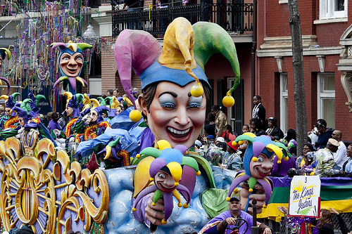
The Truth of Mardi Gras
Now, with a partner, rewrite the myth, correcting the six falsehoods.
MYTH: Mardi Gras is one big parade put on by the city in the French Quarter of New Orleans on Fat Tuesday where people drink a lot and woman lift their tops to earn beads.

